Slide 1


Preparing Visuals of Data Analysis
The selling point of your research

Slide 2
Effective Data Visualization
Facilitates Communication: Data visualization serves as a powerful tool for effective communication.
Increases Data Accessibility: Visualizations can be designed to be user-friendly, allowing even non-technical individuals to interact with data and extract meaningful insights.
Enhances Storytelling: Visualizations can turn data into compelling narratives.

Slide 3
Introduction
We have Reproducibility in Data Science - but what about charts?
Telling the same story over and over - the link between Reproducibility and Interpretability.
Reproducibility and Validation of your charts can be even easier than the BIA workflow or Image scripts. And it is highly Reusable!

Slide 4
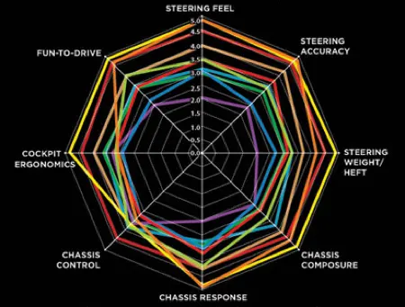
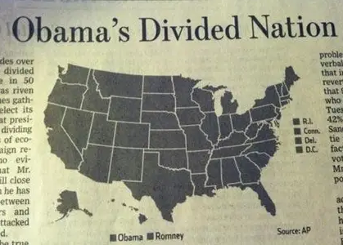
Introduction to Charts
Does not matter if you use Power BI, Tableau, MS Excel, Adobe Illustrator or Python, there are some guidelines.
Martins TV infographic rule: If you can’t make sense of it in 5s, It is too complex!

Slide 5
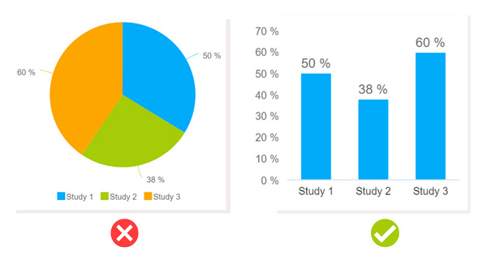
“Marketing rules”
Respect your audience
This means don’t mislead them by making bad infographics
Quality data is a non-negotiable
Provide plenty of context in your infographic
Ask yourself if you’re using the best visual
Always pay attention to the axes
Please minimize clutter in your infographic
Use titles and labels to clarify
Use color intentionally
Own and correct your mistakes if you create a bad infographic

Slide 6
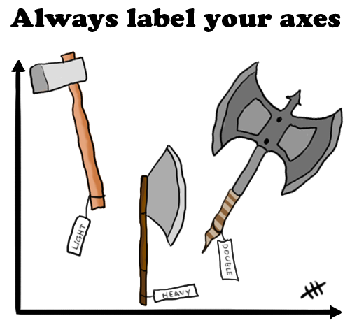
But what about some minimal approach?
Source: https://flowingdata.com/2012/06/07/always-label-your-axes/

Slide 7
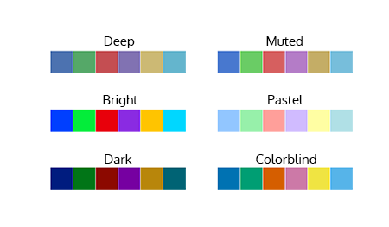
Reflecting Color Palettes
Defining color palettes and their significance in image presentation
Color palettes == set of predefined colors for data visualization
Know how you present, and to whom! Screen/Projector/Print

Slide 8
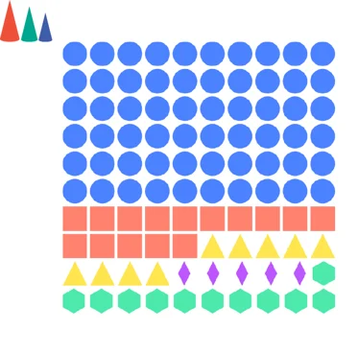
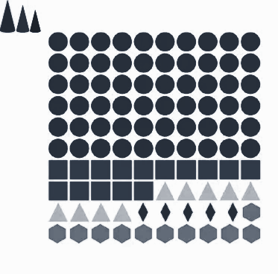
Impact of color palettes on clarity, contrast, and accessibility
Importance of choosing appropriate color palettes for data visualization
Usually easiest way is thinking grayscale - and using different marks!
“Perfection is achieved not when there is nothing more to add, but when there is nothing left to take away.”
— Antoine de Saint-Exupery.
Notes:
https://www.datylon.com/blog/data-visualization-for-colorblind-readers

Slide 9
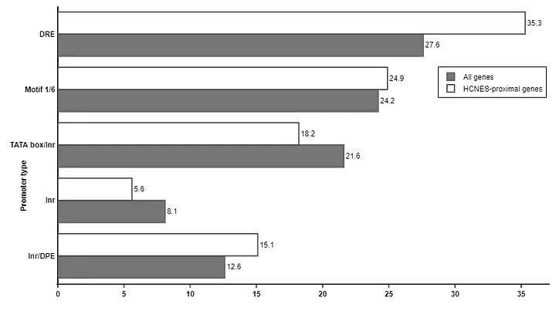
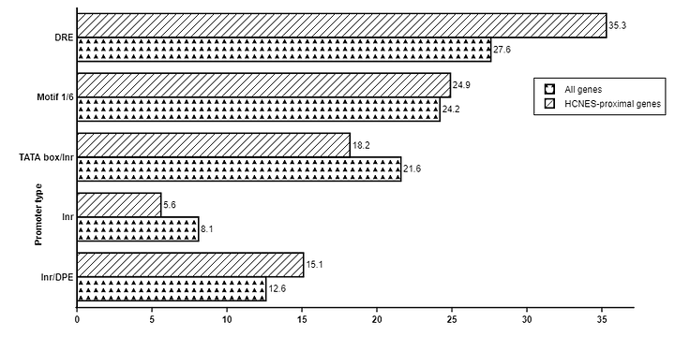
Impact of color palettes on clarity, contrast, and accessibility
Ensuring effective representation of data categories and variations
“Perfection is achieved not when there is nothing more to add, but when there is nothing left to take away.”
— Antoine de Saint-Exupery.

Slide 10
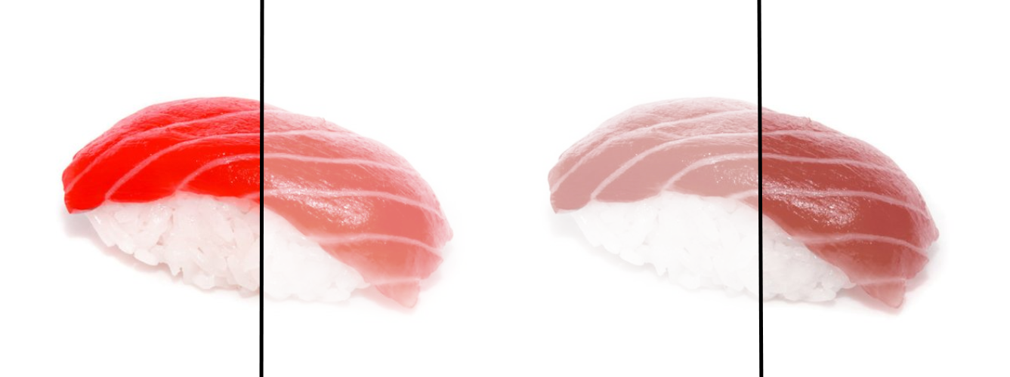
Screen/Projector/Print
RGB
Projector
CMYK

Slide 11
Considering color blindness and accessibility guidelines
Best practices for selecting color palettes
Consider number of classes/elements in your chart
Choose predefined paletes
They have high contrast
They consider color blindness and accessibility guidelines
If you are not sure - test it!

Slide 12
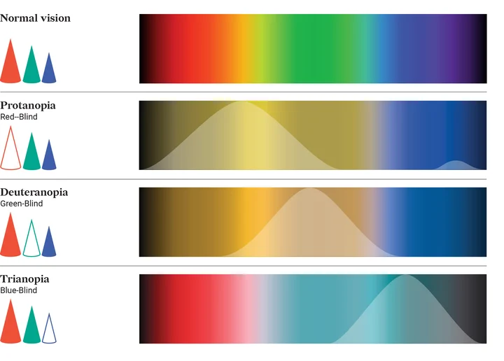
Considering color blindness

Slide 13
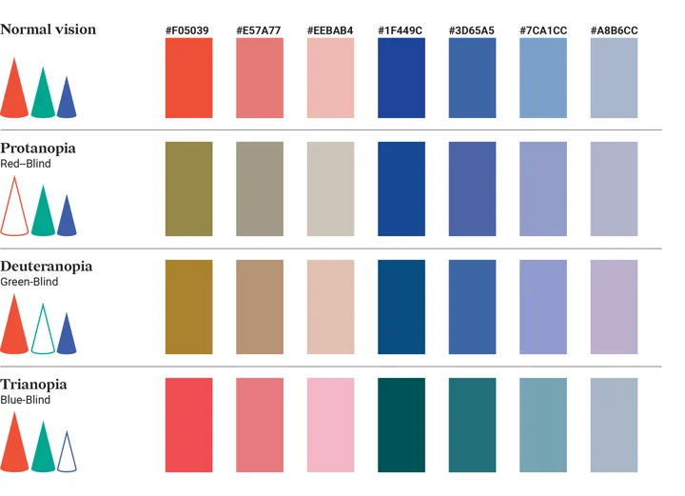
Considering color blindness
Avoid combination of red and green!
Use only two basic hues: blue and red (orange and yellow will also fit). The other colors should be made out of these two hues. All the variations can be made by using different saturation or lightness of the basic color.

Slide 14
References & Utilizing color palette tools and resources for guidance
Color Theory 101:
https://blog.hubspot.com/marketing/color-theory-design
Color Blindness Tests:
https://daltonlens.org/colorblindness-simulator
https://www.color-blindness.com/coblis-color-blindness-simulator/
Color Blindness Tests Python package:
https://github.com/DaltonLens/DaltonLens-Pythonhttps://github.com/DaltonLens/DaltonLens-Python

Slide 15
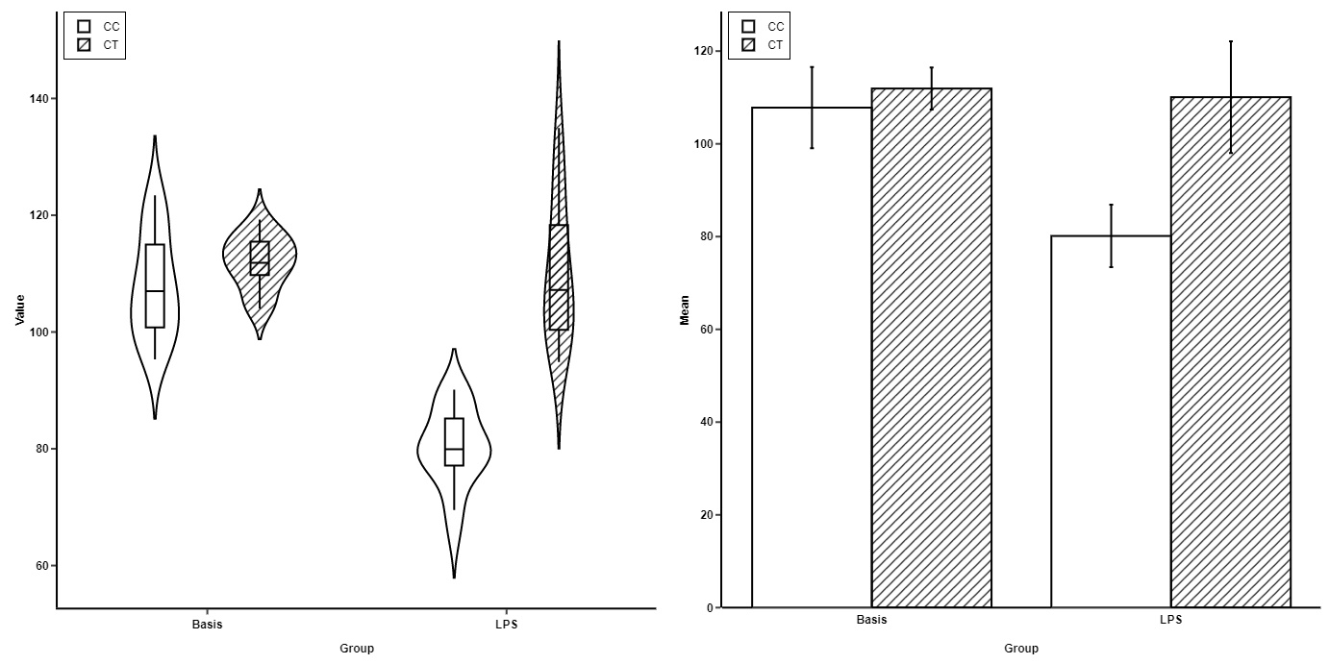
Choosing Right Chart

Slide 16
Choosing Right Chart

